Slide 1


Your Home, Your Way
Discover a world of reliable home cleaning services. Our app connects you with experienced and trusted maids, making life easier and your home sparkling clean.
by HARSH VARDHAN SINGH

Slide 2
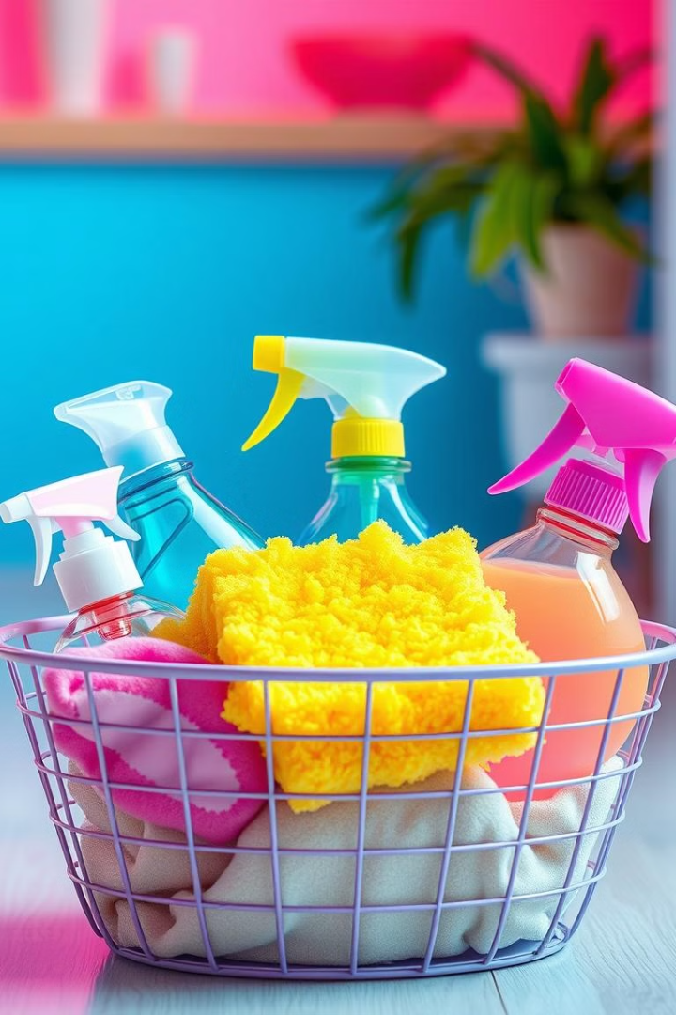
Featured Services
1
General Cleaning
2
Deep Cleaning
Thorough cleaning of all rooms, including dusting, vacuuming, and mopping. Perfect for a regular cleaning routine.
A comprehensive cleaning experience that tackles even the most stubborn dirt and grime, leaving your home spotless.
3
Laundry
4
Window Cleaning
Professional laundry services for all your clothes, linens, and bedding, including washing, drying, and folding.
Expert window cleaning services that restore sparkle to your windows, ensuring crystal-clear views.

Slide 3
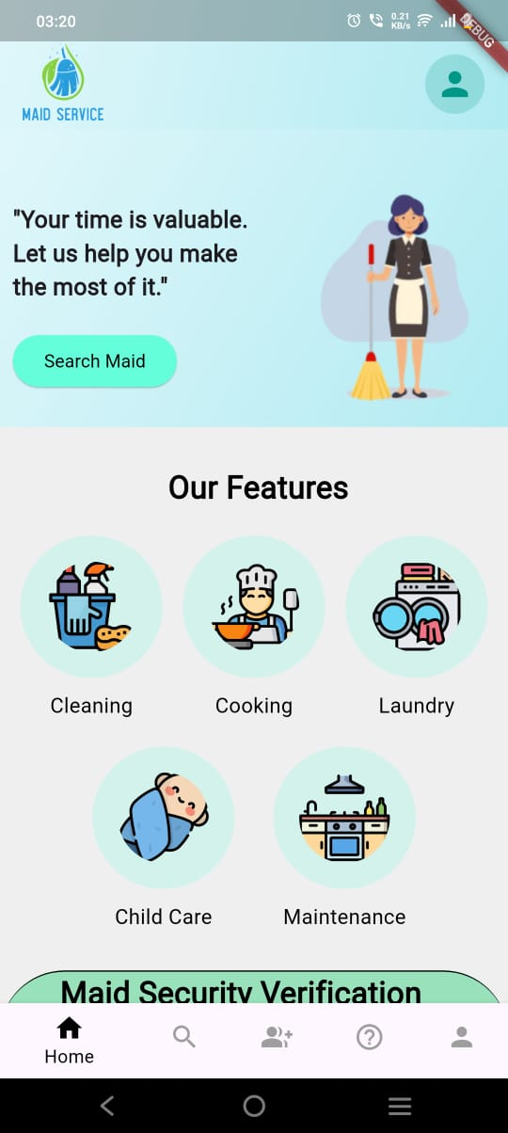



How It Works
Sign Up
Download the app and create an account in seconds. It's fast and easy!
Choose your maid
Select your preferred cleaning services, choose a maid that suits you, and confirm your maid.
Enjoy a Clean Home
Relax and enjoy a clean and sparkling home, knowing that our maids are professional and reliable.

Slide 4
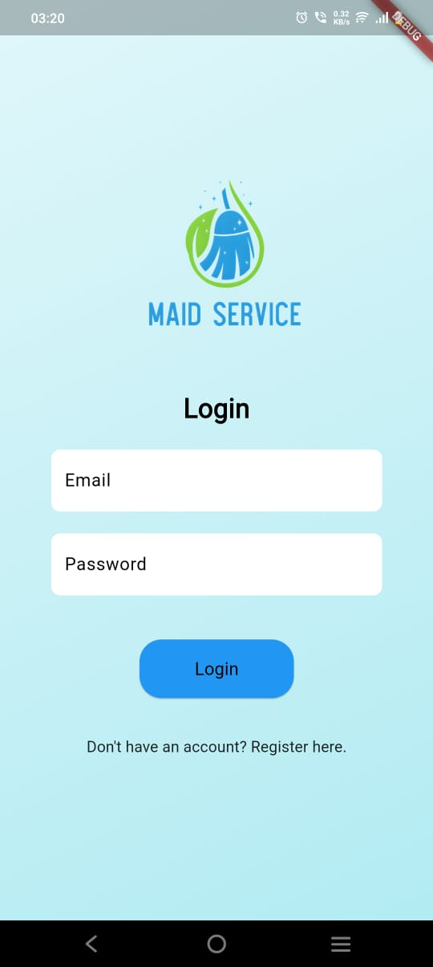
Booking Process
1
Search
Find available maids in your area based on your desired services.
2
Select
Choose a maid profile that meets your preferences and see their experience and ratings.
3
Confirm
Review your maid details, including the service, date, time, and price, and confirm your request.
4
Enjoy
Receive a confirmation notification and relax knowing that a professional maid is on their way to work at your home.

Slide 5
Maid Profiles
Experience & Skills
Customer Ratings & Reviews
Contact & Communication
View each maid's profile to see their years of experience, expertise in various cleaning tasks, and specializations.
Communicate directly with the maid through our in-app messaging system to discuss your cleaning needs and preferences.
Read verified reviews from other customers who have used our services to get a sense of the maid's quality and reliability.

Slide 6
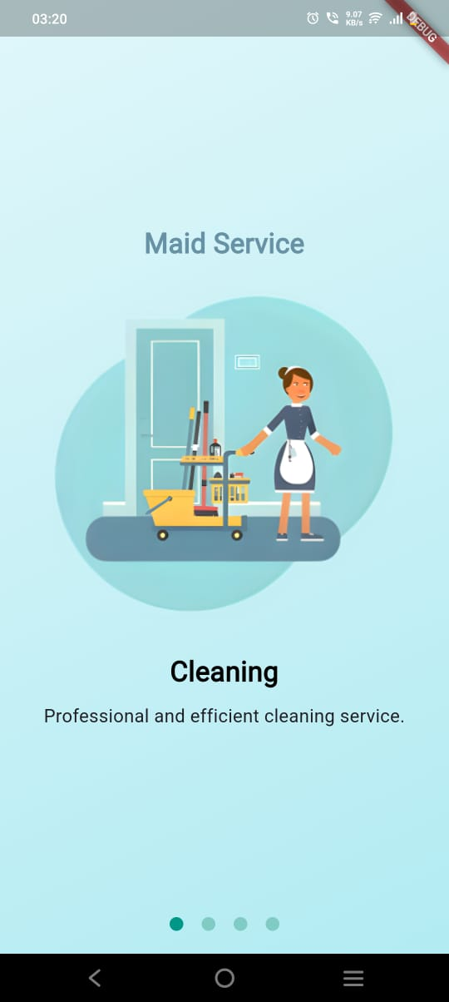
Special Offers
First-Time Users
Recurring Bookings
Enjoy a special discount on your first booking to experience our services and find your perfect maid.
Save money with discounts on recurring bookings, ensuring a consistent and affordable maid.
Seasonal Promotions
Take advantage of limited-time offers throughout the year, including holiday deals and seasonal specials.

Slide 7




Download the App
Convenience
Trust & Security
Customer Support
Book services, manage appointments, and communicate with maids, all from the comfort of your phone.
Our rigorous vetting process ensures that all maids are background-checked and reliable, so you can rest assured.
Our friendly and helpful support team is available to assist you with any questions or concerns you may have.

Slide 8

Contact Us
We are always here to help. You can reach us by phone, email, or through our app.
Name-Harsh Vardhan Singh
Phone - 7983859927
harshvardhansinghha@gmail.com

